Slide 1
Introduction to Statistical Learning
Tianhang Zheng
https://tianzheng4.github.io

Slide 2
Course Website
https://tianzheng4.github.io/umkc-teaching/2023-fall-teaching-1/
What are on the course website:
Lecture slides
Lab material
Contact Information
If you are interested in my research, feel free to contact me.

Slide 3
Assignments and Requirements
Course + Lab: Theory and Implementation 30%
Course Project: Maximum four people in one group 20%
Mid-term and Final Exams 20% + 30%

Slide 4
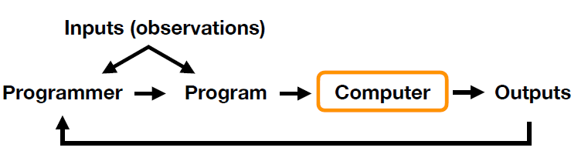
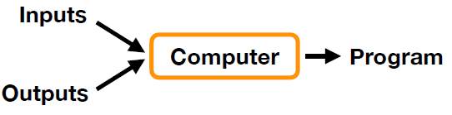
Statistical Learning v.s. Tradition Programming
Traditional Programming: Given inputs, developers define the rules and program to obtain the outputs
Learning: Given inputs and outputs to learn the rules/program

Slide 5
Statistical Learning v.s. Machine Learning
Definition (Mitchell, 1998)
A computer program is said to learn from experience E with respect to some class of tasks T and performance measure P, if its performance at tasks in T, as measured by P, improves with experience E.
Machine learning and deep learning emphasize large scale applications and prediction accuracy.
Statistical learning emphasizes models and their interpretability, and precision and uncertainty.

Slide 6
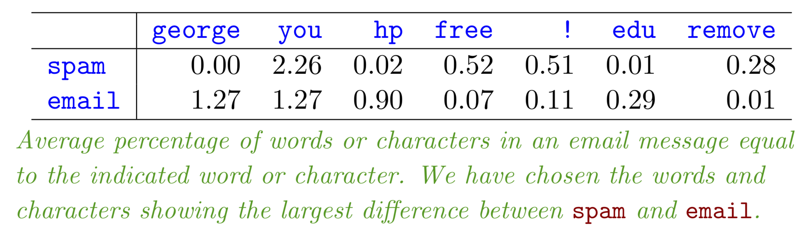
Spam Detection
Given features of emails, build a spam filter

Slide 7
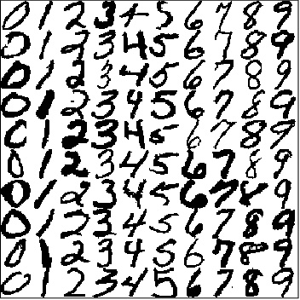
Digit Recognition
Given the images of handwritten digits, recognize the digits
MNIST dataset
https://www.kaggle.com/datasets/hojjatk/mnist-dataset

Slide 8
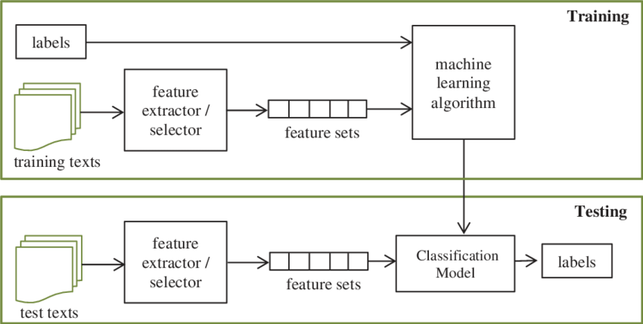
Text Classification

Slide 9
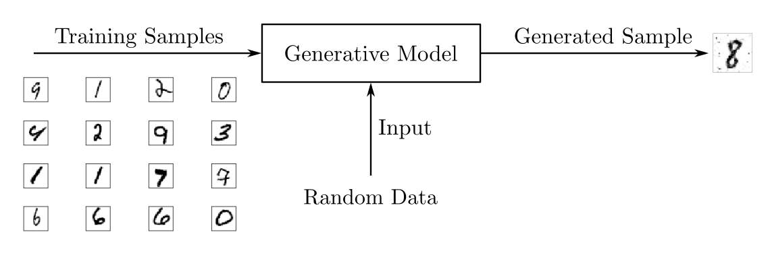
Generating New Samples (Generative Models)

Slide 10
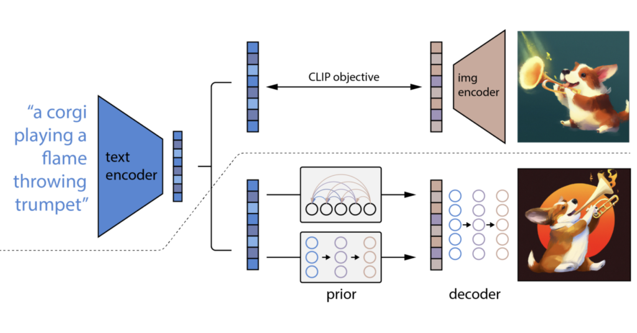
Text-to-Image Generation

Slide 11
Applications of Statistical Learning
bioinformatics
detecting network intrusion
neuroscience
medical diagnosis
stock market analysis
social network analysis
traffic and infrastructure planning
…

Slide 12
Textbooks
An Introduction to Statistical Learning
Machine Learning with Python Tutorial (Optional)
https://tianzheng4.github.io/umkc-teaching/2023-fall-teaching-1/

Slide 13
Supervised Learning
Vector/Matrix/Tensor predictor X (also called inputs, regressors, covariates, features, independent variables)
Outcome Y (also called dependent variable, response, target)
Objectives:
Accurately predict the outcomes of unseen test cases
Understand which inputs affect the outcome, and how
Assess the quality of our predictions and inferences

Slide 14
Supervised Learning
New Input
Linear Regression
X: Inputs
Machine Learning Algorithm
Model
Y: Outcomes
Logistic Regression
Outcome

Slide 15
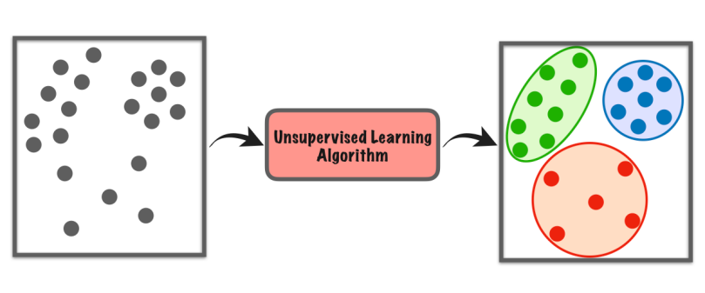
Unsupervised Learning
No outcome variable, just a set of predictors (features) measured on a set of samples.
Objectives:
Find groups of samples that behave similarly
Find the most important sets of features

Slide 16
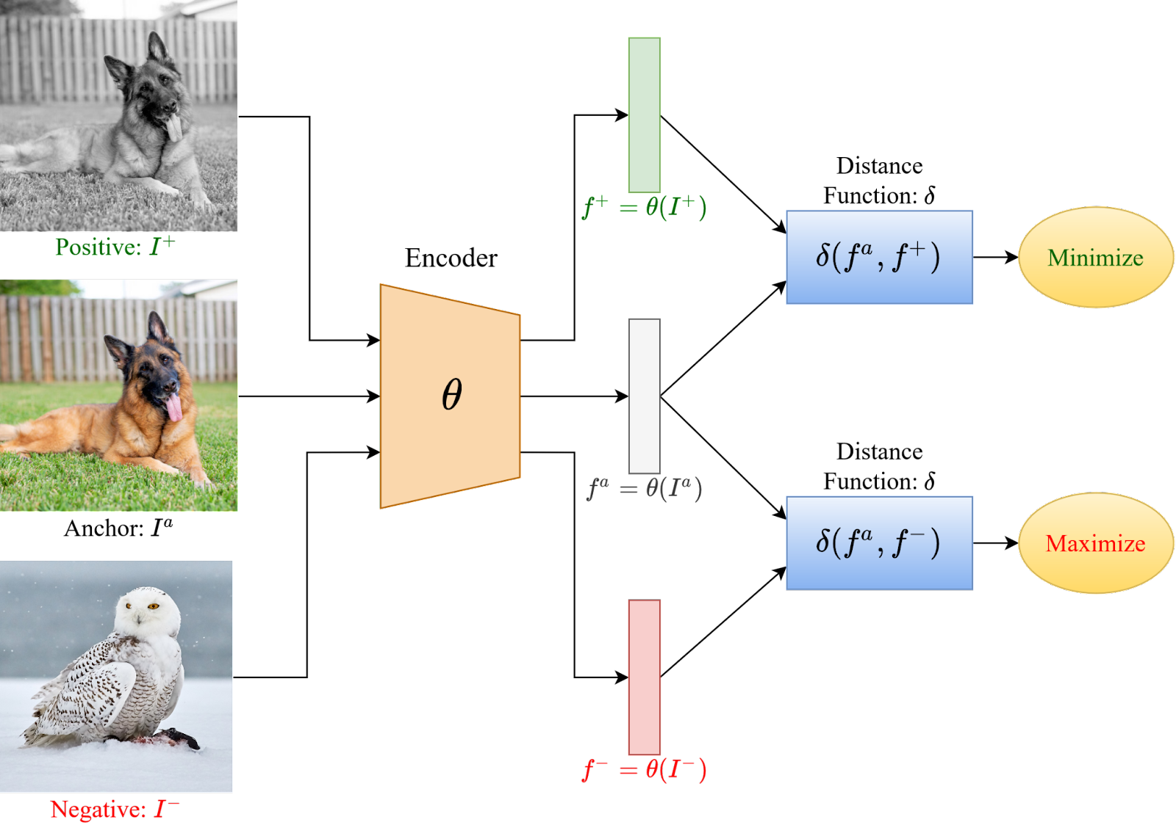
Unsupervised Learning

Slide 17
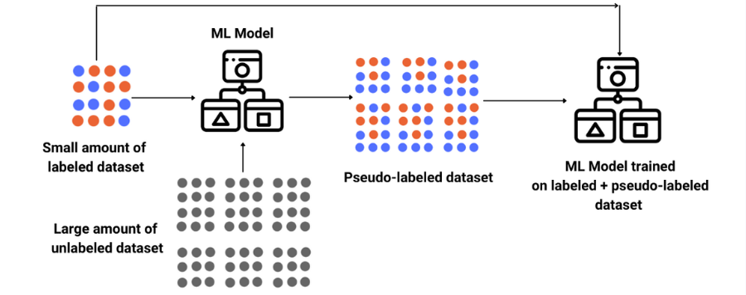
Semi-Supervised Learning
Semi-supervised learning can be viewed as a mix of supervised and unsupervised learning.
In semi-supervised learning tasks, some training examples have outcomes, but some do not.

Slide 18

Reinforcement Learning

Slide 19
Category of learning problems
Spam Detection: Supervised or Unsupervised?
Digit Recognition: Supervised or Unsupervised?
Generative Models: Supervised or Unsupervised?
Text-to-Image Generation: Supervised or Unsupervised?

Slide 20
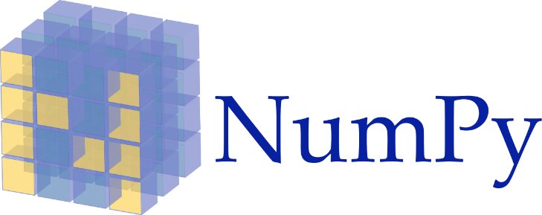





Implementation Tools

Slide 21
Python Resources
Kaggle: https://www.kaggle.com/learn/python
Learn Python: https://www.learnpython.org/
Python for Beginners by Microsoft: https://learn.microsoft.com/en-us/shows/intro-to-python-development/
Python for Everybody (up to 6 hours): https://www.youtube.com/watch?v=8DvywoWv6fI
Google it
Introduction to Python (next course)

Slide 22
Course Website
https://tianzheng4.github.io/umkc-teaching/2023-fall-teaching-1/
What are on the course website:
Lecture slides
Lab material
Contact Information
If you are interested in my research, feel free to contact me.

Slide 23
Q & A

